Slide 1
Camouflage and Computer Vision
Tim Volonakis

Slide 2
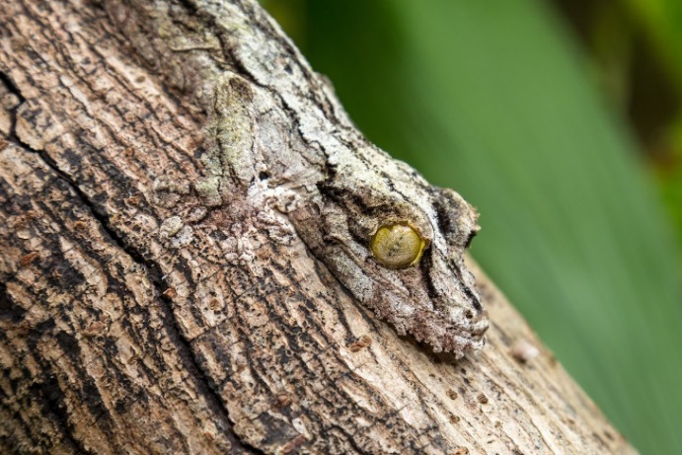
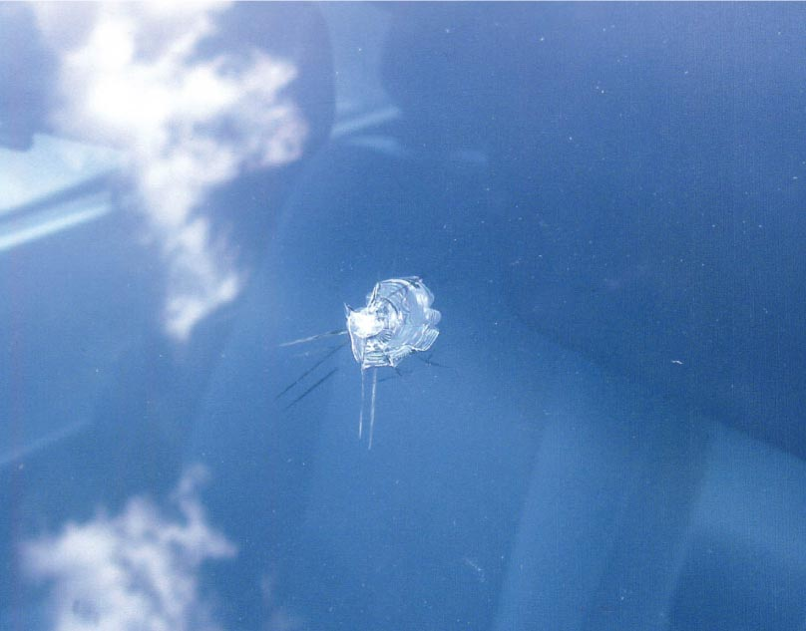
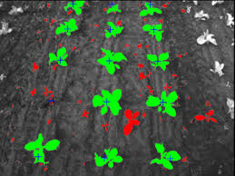
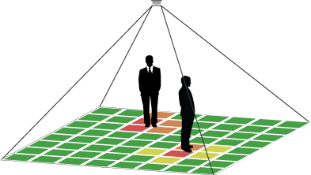







Introduction
Camouflage
Autoglass
Weed Detection
Action Recognition

Slide 3
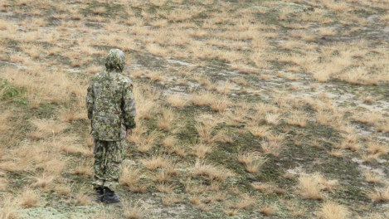


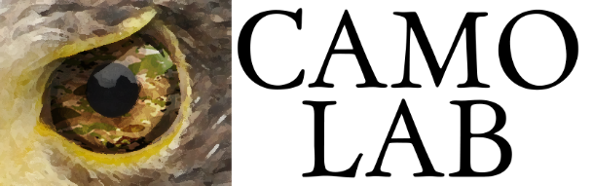
Camouflage Assessment

Slide 4
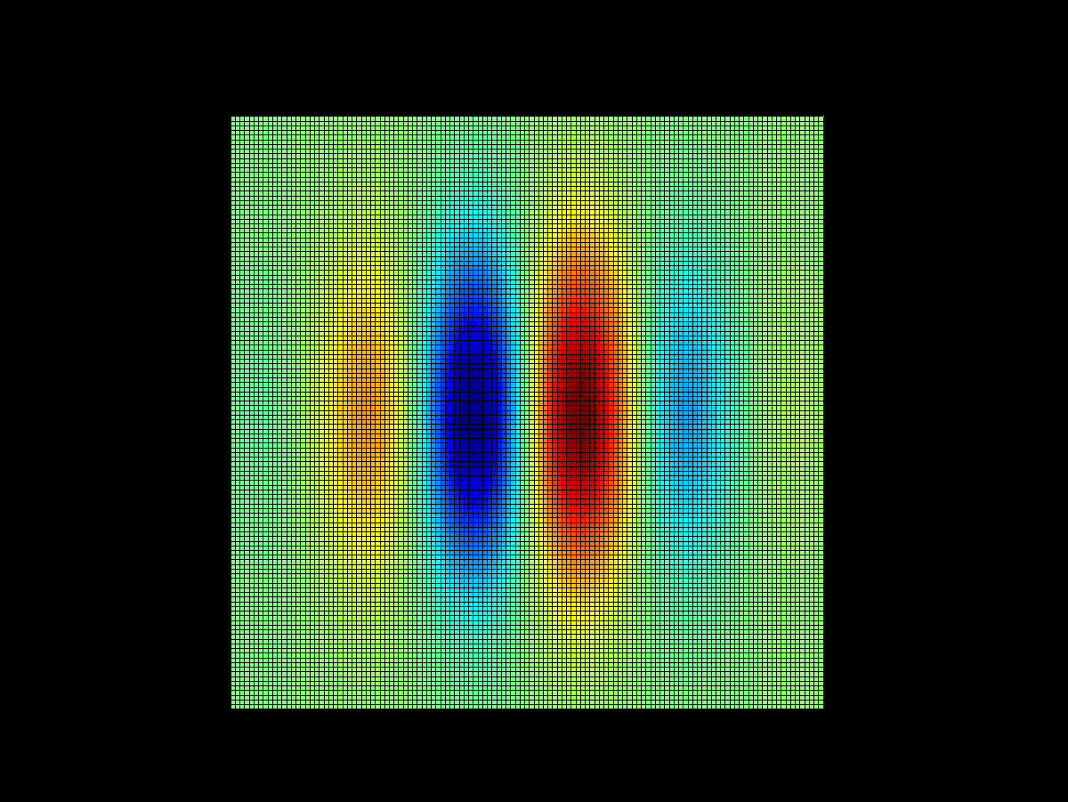
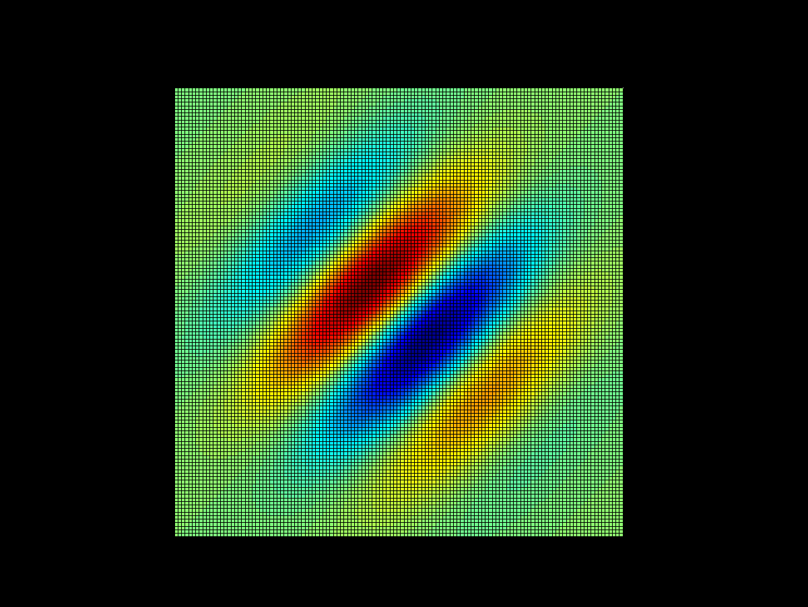
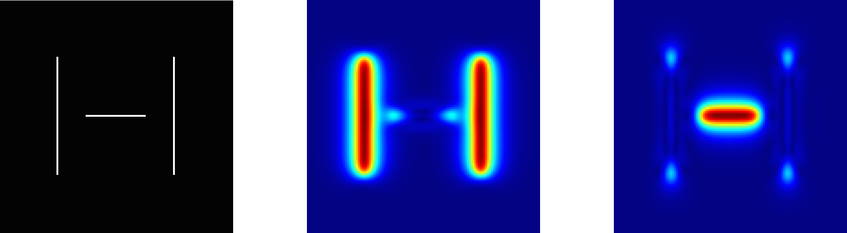
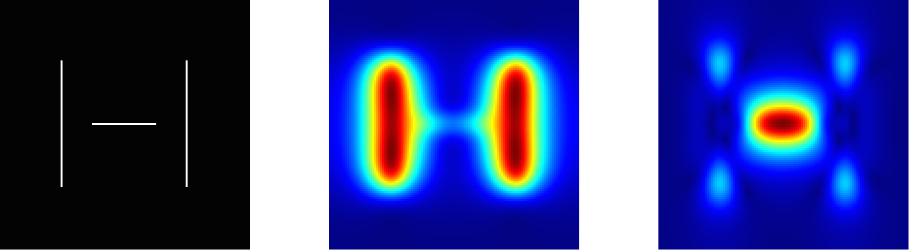
The Observer Model
1. Filter with log Gabors
2. Compute Local Energy and Phase
3. Sample
4. Model using mixture Of Gaussians
Volonakis, T. N., Matthews, O. E., Liggins, E., Baddeley, R. J., Scott-Samuel, N. E., & Cuthill, I. C. (2018). Camouflage assessment: Machine and human. Computers in Industry, 99, 173-182.

Slide 5
Modelling Colour
Colour in the periphery
What colour features
How to combine texture and colour features

Slide 6
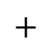








MacLeod & Boynton Colour Space
S
M
L
M
L
M
L
$+$
$−$
$−$
$−$
$+$
$+$
$+$
$$+$$
S vs. LM
L vs. M
L $+$ M

Slide 7
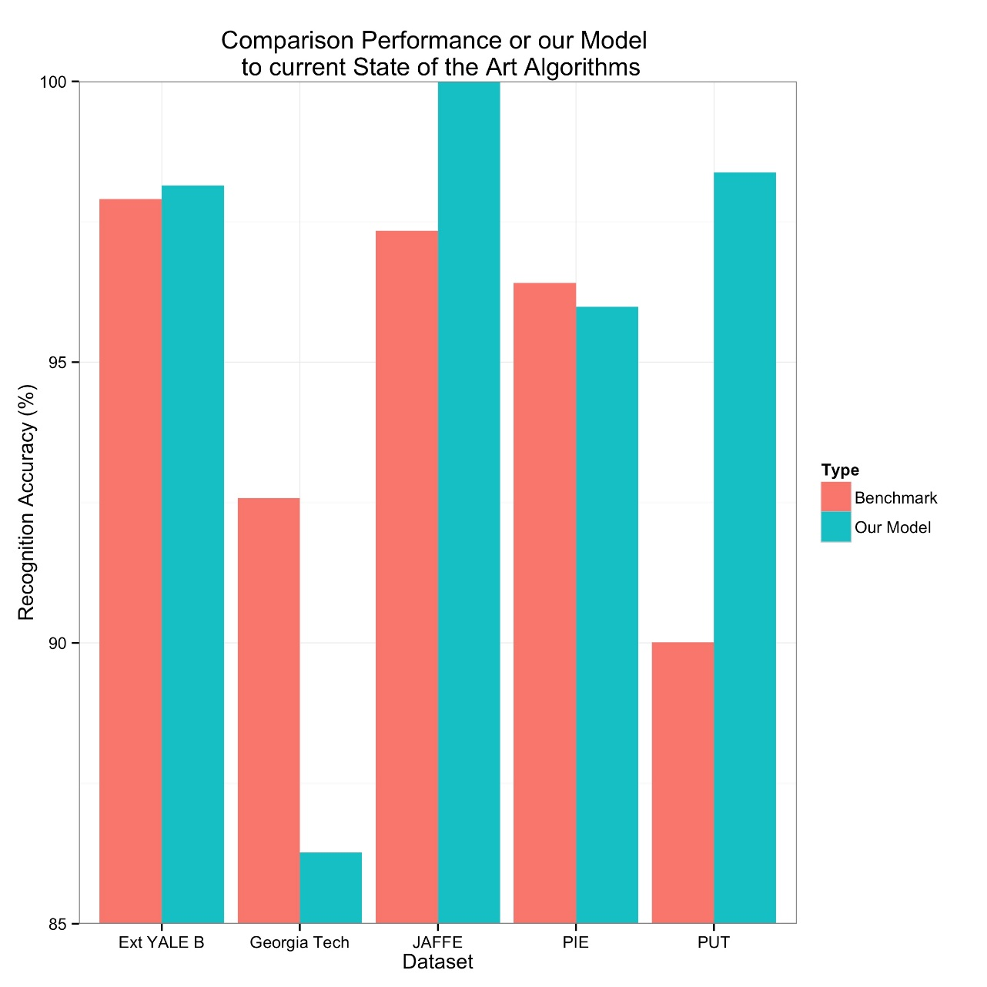
Accuracy at Face Recognition
Accuracy Comparison with State of the Art (at the Time)

Slide 8
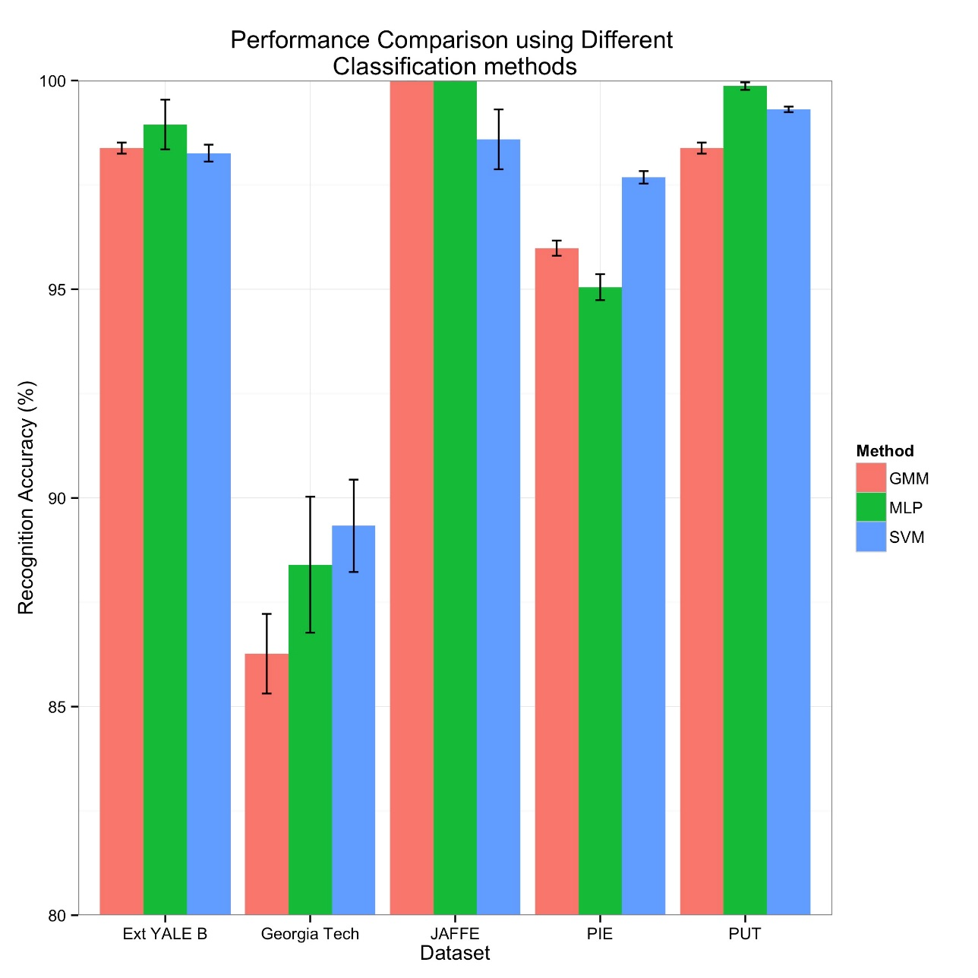
GMM vs. MLP vs. SVM
Accuracy Comparison with Different Machine Learning Architecture

Slide 9
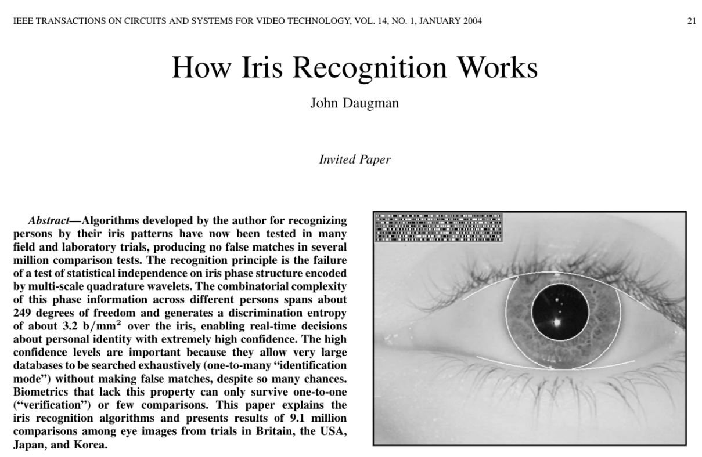
Local Energy and Phase is powerful at representing objects
Features Are Good

Slide 10
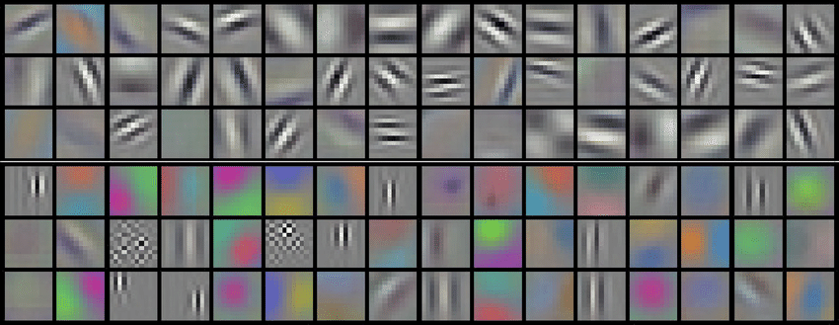
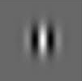
Features are Present in 2D Conv Nets
Krizhevsky’s Features from ImageNet
2D Gabor

Slide 11
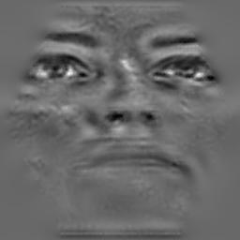
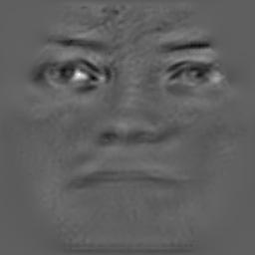
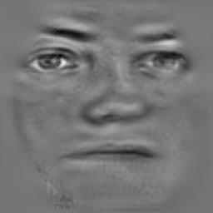
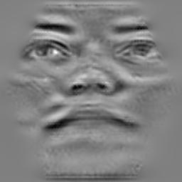
Variations in Head Pose

Slide 12
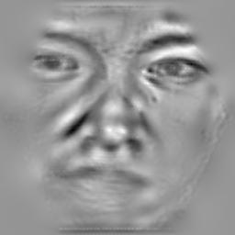
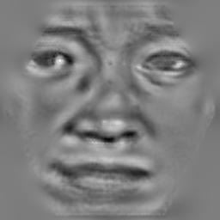
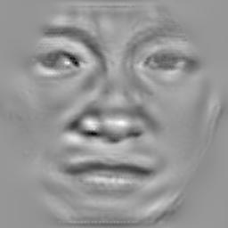
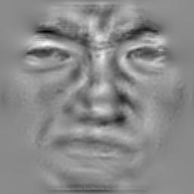
Variation in Facial Expressions

Slide 13
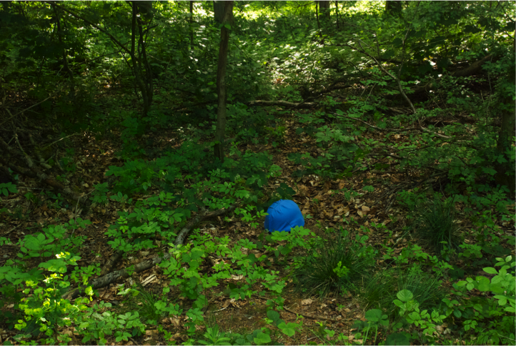
Camouflaged Objects in Woodland

Slide 14
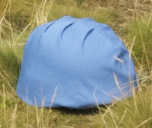
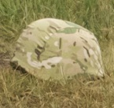
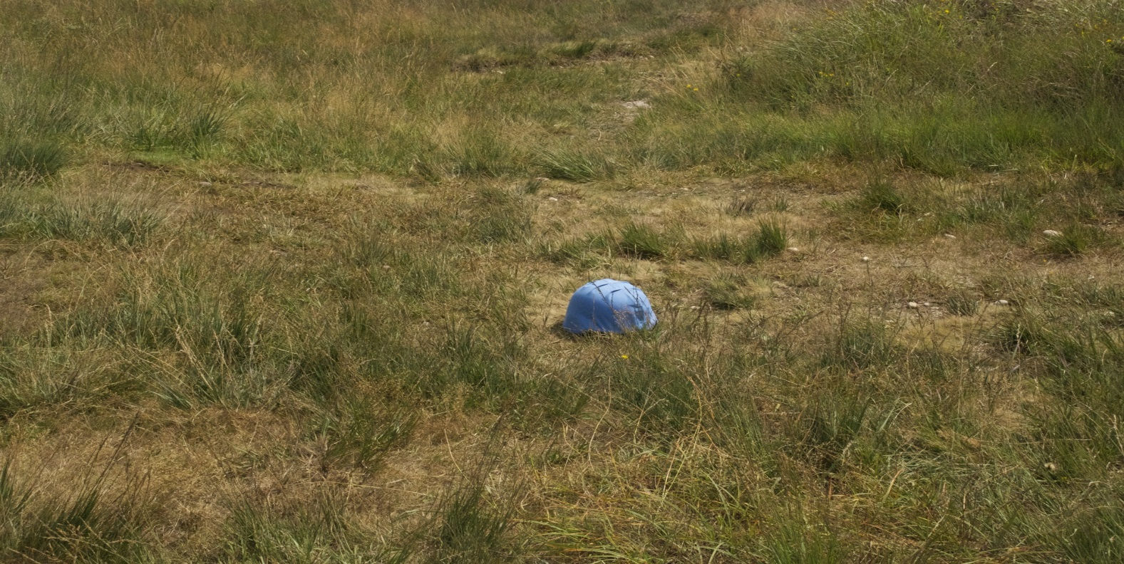
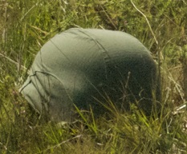
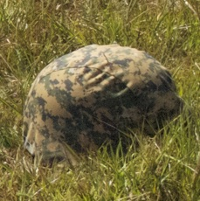
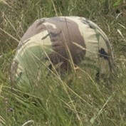
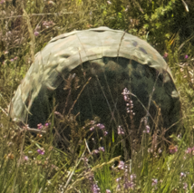
Camouflaged Objects in Scrubland

Slide 15
Comparing Accuracy
Both observers’ behaviour needs to be compared
We need to task them with the SAME task

Slide 16
The Human Experiment (1/4)

Slide 17
The Human Experiment (2/4)

Slide 18
The Human Experiment (3/4)

Slide 19
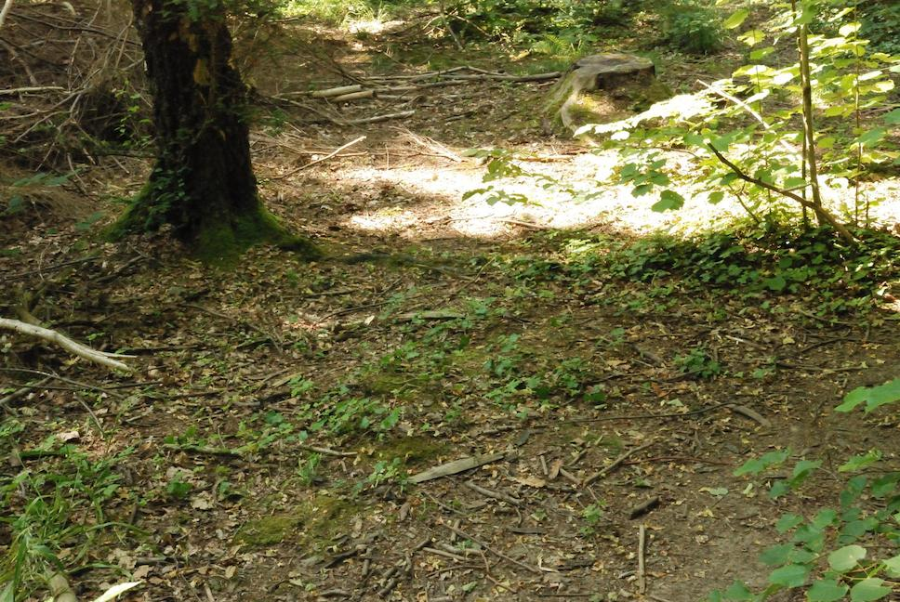
The Human Experiment (4/4)

Slide 20
Bayesian Recognition
A
Show a pair of unseen images to the model
One helmet, one background
Evaluate maximum posterior probability which is a helmet
B

Slide 21
Bayesian Recognition
Helmet
Background
Models
P(A|Background)
P(A|Helmet)
P(B|Background)
P(B|Helmet)
A
B
Images

Slide 22
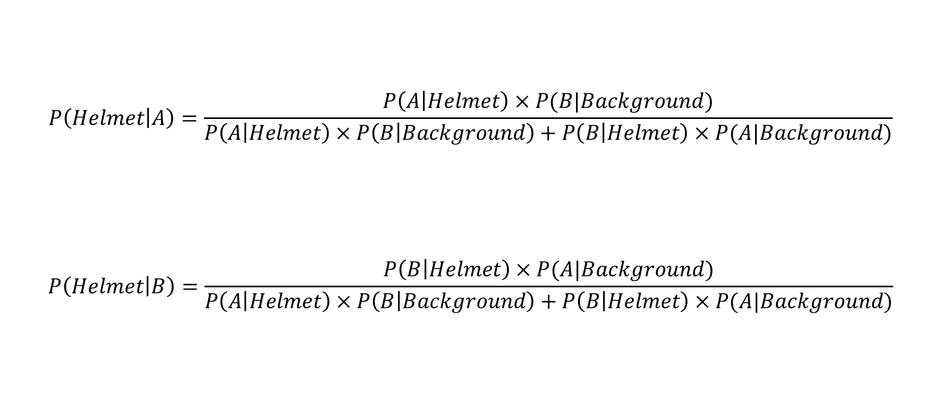
Bayesian Recognition

Slide 23
Bayesian Detection
A
Scene
B

Slide 24


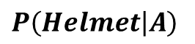

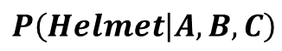
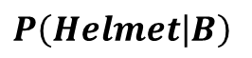

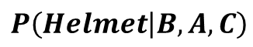
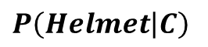

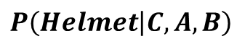
Bayesian Detection
A
$$P\left(Helmet | A\right)$$
$$×$$
$$P\left(Helmet | A,B,C\right)$$
$$+$$
$$P\left(Helmet | B\right)$$
$$×$$
$$P\left(Helmet | B,A,C\right)$$
B
$$+$$
C
$$P\left(Helmet | C\right)$$
$$×$$
$$P\left(Helmet | C,A,B\right)$$

Slide 25

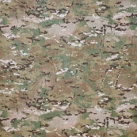
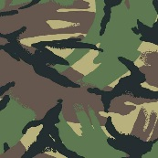
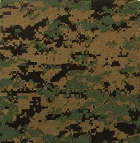
Greyscale Recognition: Woodland
Model Accuracy (%)
Human Accuracy (%)

Slide 26
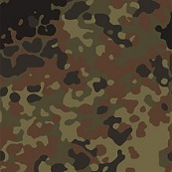
Greyscale Recognition: Scrubland
Model Accuracy (%)
Human Accuracy (%)

Slide 27
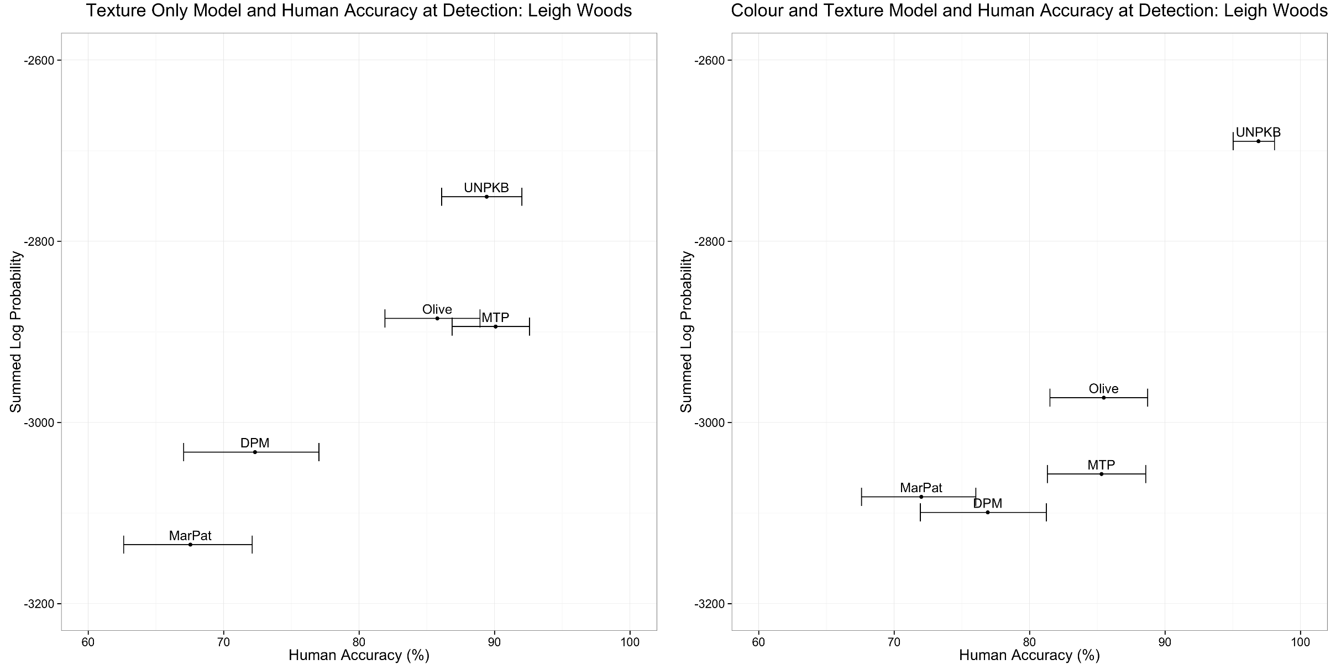
Helmet Detection: Woodland
Accuracy at Detection (Texture): Woodland
Accuracy at Detection (Colour Texture): Woodland

Slide 28
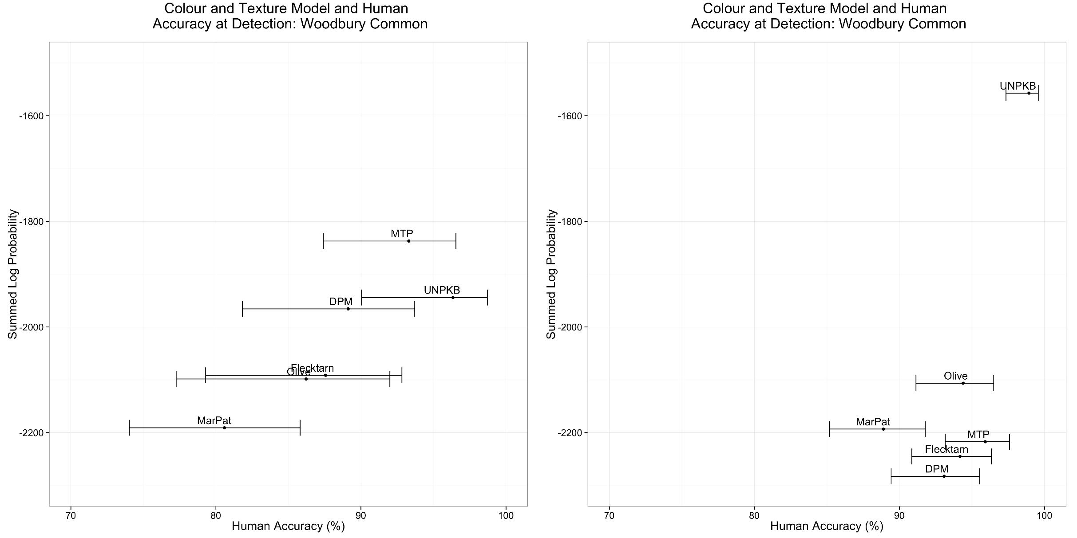
Helmet Detection: Scrubland
Accuracy at Detection (Texture): Scrubland
Accuracy at Detection (Colour & Texture): Scrubland

Slide 29
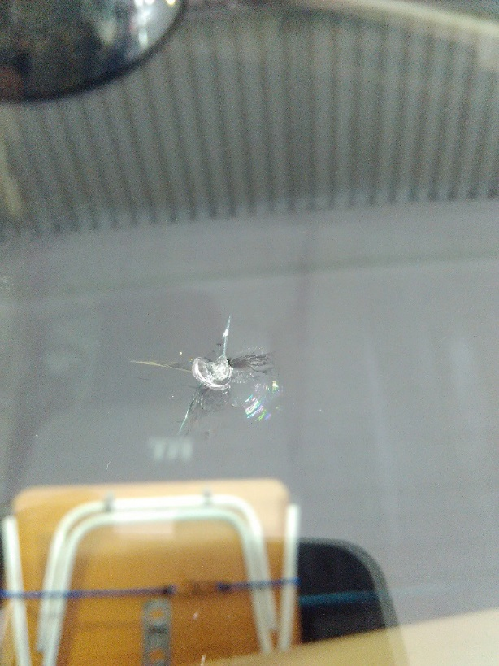
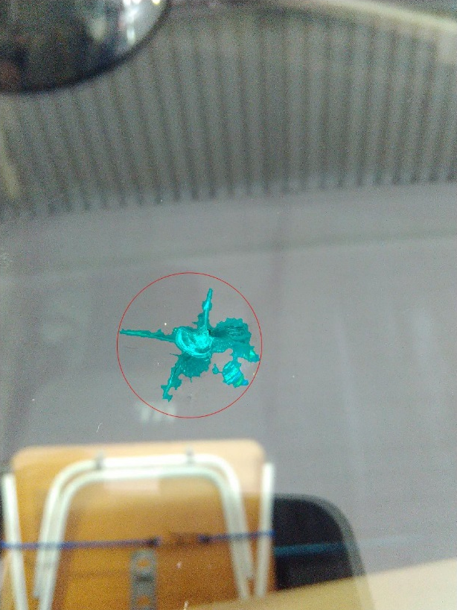


Windscreen Cracks

Slide 30
Windscreen Cracks – One Approach
Find the centre of impact
Log Polar Transform immediate area
Evaluate ‘spider legs’
If lots of vertical information – likely to be a crack

Slide 31
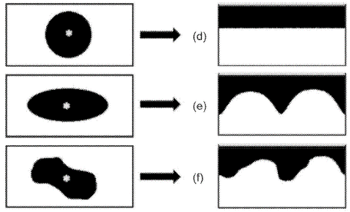
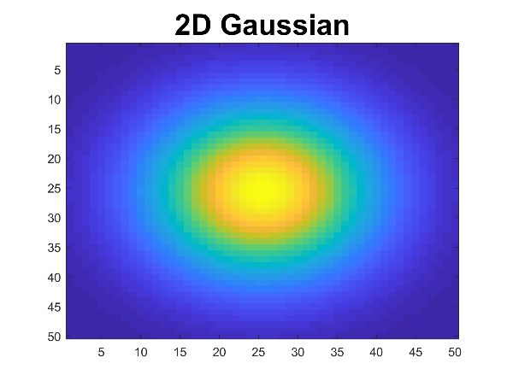

One Approach - Polar Transform
Cartesian Domain
Polar Domain
Circle
Ellipse
Irregular Polygon
Gaussian

Slide 32


Boolean Map Saliency
Original Image
BMS Saliency

Slide 33

Detecting the Centre of Impact
Original Image
BMS Saliency

Slide 34



Detecting the Centre of Impact

Slide 35

Saliency Benchmark
Deep Learning Dominating!!

Slide 36

Log Polar Transform Features
1. Image
2. Edges
(Canny)
3. Log Polar Transform
4. Vertical Information Retained

Slide 37



Segmentation Algorithm
1. Original Image
2. Butterworth Band passed
3. Threshold

Slide 38


Windscreens are Dirty

Slide 39
What Dust Looks Like

Slide 40

Dust Detection
Compute the horizontal and vertical gradients
Convolve with DoG
Sum vertical and horizontal output

Slide 41
Dust Detection: Image Pipeline
Image Input
(Dust)
Horizontal Gradient
Convolved with DoG

Slide 42
Dust Detection: Image Pipeline
Original Dust Input
Final Dust Representation

Slide 43

Dust Particle Detection
Original Image
Detected Dust in Red

Slide 44

Dust Particle Detection
Original Image
Detected Dust in Red

Slide 45










Neural Network Dust Classifier
DUST
NOT-DUST
2 Nodes for Classification
400 (${20}^{2}$) Input for
Dust and Not-Dust Images
100 Hidden Nodes

Slide 46

Real World Rectification
Show triangulation with phone

Slide 47

Ground Truth vs Estimate Size
Correlation: 0.58
Strong Correlation

Slide 48

Automotive Body Damage Analysis

Slide 49


Challenging Problem
Image of a Dent
3D Project Key points

Slide 50



Plaster of Paris Mould

Slide 51


Fringe Pattern Projection

Slide 52


Polarisation
Without Polarisation
Using Polarisation Filters

Slide 53


3D Reconstruction of Dent
RAW Fringe 3D Reconstruction
Interpolated Fringe Reconstruction

Slide 54



Compare with Ground Truth
Iterative Closest Point Matching
Ground Truth
Fringe Reconstruction

Slide 55

3D Reconstruction Accuracy
Show real sense and laser accuracy
3D Measurement Error (mm)

Slide 56

Weed Detection

Slide 57


Example Images of Dock Weed
Image
Dock Leaves Labelled
RED: Dock leaves

Slide 58


Labelling Dock is Non-trivial
Image
Dock Leaves Labelled
RED: Dock leaves

Slide 59
Detection for Spray Boom
1 metre
1 metre

Slide 60


Recognition Approaches
Local Binary Patterns
&
Support Vector Machine
Convolutional Neural Network
Pre-trained on ImageNet

Slide 61
Results at Weed Recognition
Local Binary Patterns + SVM
Convolutional Neural Network
 | Grass | Dock
Grass | 0.80 | 0.20
Dock | 0.06 | 0.94
 | Grass | Dock
Grass | 0.93 | 0.07
Dock | 0.01 | 0.99
Average Accuracy: 87.0%
Average Accuracy: 96.0%
Zhang, W., Hansen, M. F., Volonakis, T. N., Smith, M., Smith, L., Wilson, J., ... & Wright, G. (2018). Broad-leaf weed detection in pasture. IEEE 3rd International Conference on Image, Vision and Computing (ICIVC) (pp. 101-105).

Slide 62
Detecting Actions in Homes
Tao, L., Volonakis, T., Tan, B., Jing, Y., Chetty, K., & Smith, M. (2018). Home Activity Monitoring using Low Resolution Infrared Sensor. arXiv preprint arXiv:1811.05416.
Tao, L., Volonakis, T., Tan. B., Zhang Z., Jing, Y. & Smith, M. (2018). 3D Convolutional Neural network for Home Monitoring using Low Resolution Thermal-sensor Array, 3rd IET International Conference on Technologies for Active and Assisted Living (TechAAL2019) (Submitted).

Slide 63


Panasonic’s 8$×$8 Infrared Sensor

Slide 64

Example Fall Sequence
An Example Fall Sequence

Slide 65

Temporal and Spatial DCT

Slide 66

3D Convolutional Neural Network

Slide 67
Summary
Camouflage
Autoglass
Weed Detection
Action Recognition

Slide 68


Local Binary Patterns
3
4
8
0
0
1
2
4
6
0
1
2
1
5
0
0
1
3$×$3 Pixel Window
Pixel Intensities
Local Binary Pattern
Binary Pattern: 1100001
= 1 + 64 + 128
= 193

